Slide 1
c-CRAFT: Computerized Class Record Assistant for Teachers of TFBC School, Inc. Grade School Department
Proponents:
BONDOC, Edsar A.
BONDOC, John Patrick M.
DUMALANTA, Ruther James E.

Slide 2
Rationale
Grading system can be computerized and centralized to lessen if not eliminate computation efforts and consolidation of grades by teachers and class advisers.

Slide 3
General Objectives
Develop a computerized grading system for TFBC School, Inc. Grade School Department.

Slide 4
Specific Objectives
Study and explain existing TFBC School, Inc. grading system.
Identify problems encountered by existing system.
Design and develop a system in terms of Security, Efficiency and Reliability.
Evaluate existing and proposed system in terms of Security, Efficiency and Reliability.

Slide 5
Hypothesis of the Study
There is no significant difference between the existing and proposed system in terms of security, efficiency and reliability.

Slide 6
Scope
Grading system of TFBC School, Inc. based on DepEd prescriptions for private schools.
Prints IRP’s, periodical and final ranking.
70-30 scheme for academic and extra-curricular ranking.

Slide 7
Limitations
Cannot be accessed online.
Excludes TFBC School, Inc. secondary school grading system.
Cannot print report cards.
Teachers cannot access the system unless appointed with at least a subject.

Slide 8
Significance of the Study
Teachers. Less task on grade computation.
Adviser. Easy consolidation of subject grades.
Principal. Ease in monitoring grade computation of teachers.
Researchers. Knowledge in system design and analysis.
Future Researchers. Study serves as a reference material.

Slide 9
System Development Methodology
Research and Development Method
Descriptive Method
Prototyping

Slide 10
Research Locale
Subjects of the Study: Teachers and principal of the grade school department of TFBC School, Inc. Main (Barangay San Vicente) and Annex (Barangay Carangian)
Population: 16 teachers and 1 principal.

Slide 11
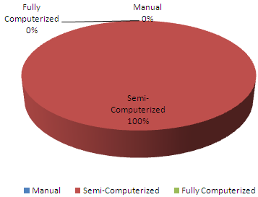
Current Mode of Grading System of TFBC School, Inc.

Slide 12
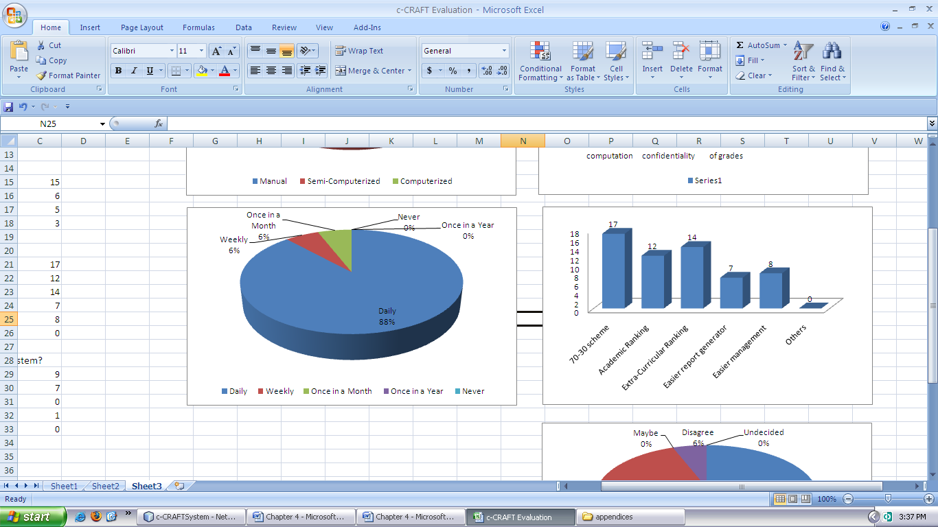
Frequency in Updating Class Records

Slide 13
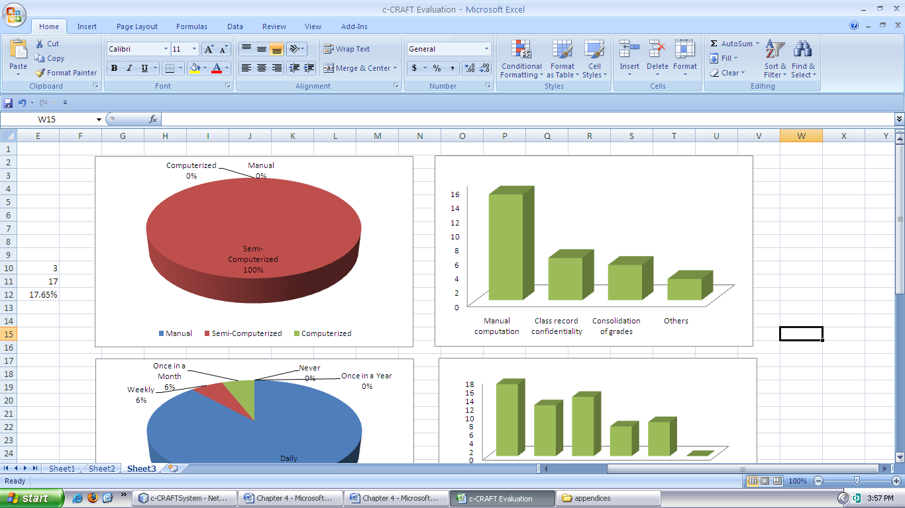
Problems encountered with the existing system

Slide 14
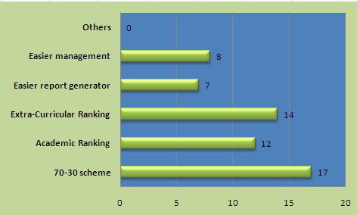
Features and Functions to be included in the proposed system

Slide 15
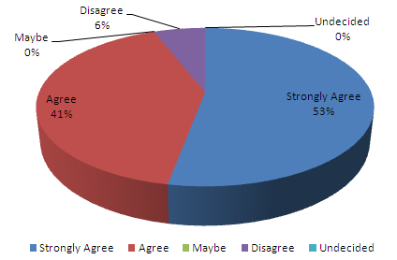
Implementation of the proposed system

Slide 16
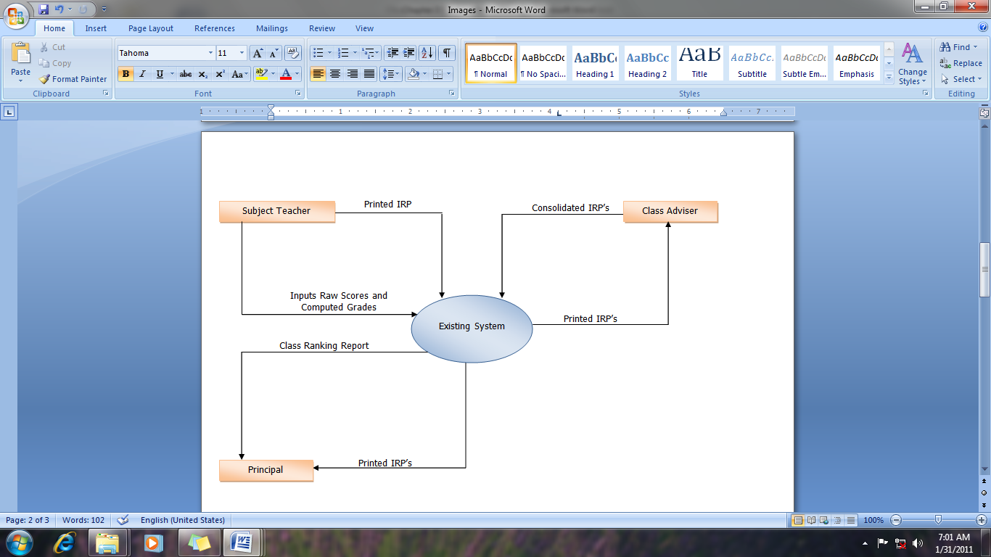
Context Diagram of the existing system

Slide 17
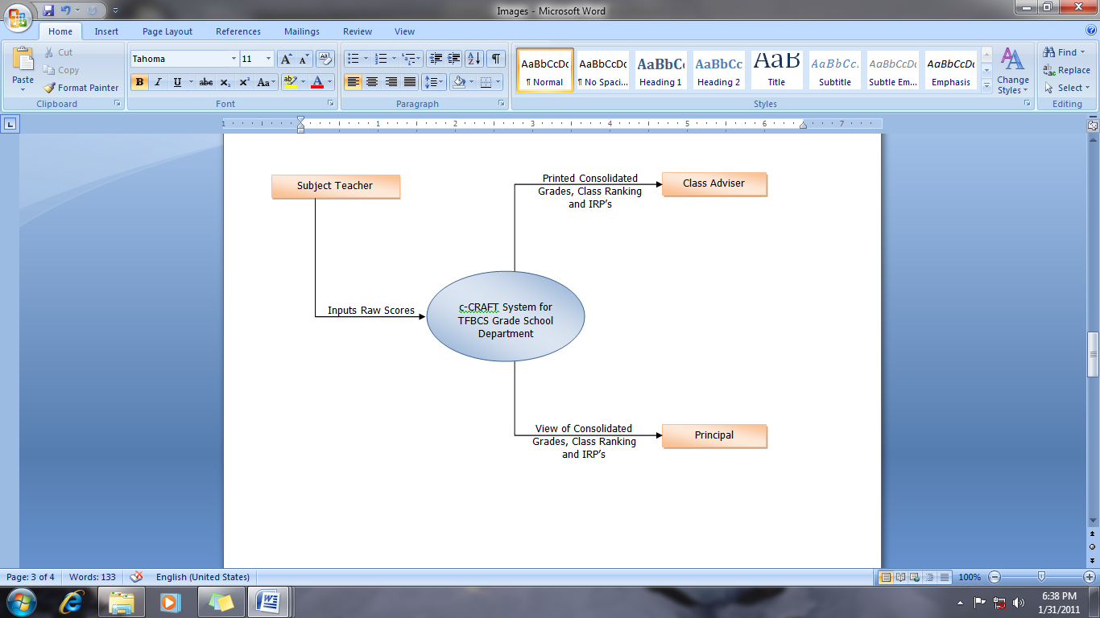
Context Diagram of the proposed system

Slide 18
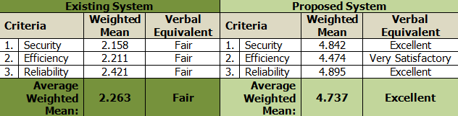
Systems Evaluation Summary

Slide 19
Conclusion
The proposed system is excellent in terms of security, efficiency and reliability. And there is a significant difference to the proposed system from the existing system, rejecting the null hypothesis where t-computed 19.56 is greater than the t-tabulated of the t-test.

